Slide 1


SHRI G. S. INSTITUTE OF TECHNOLOGY & SCIENCE, INDORE
DEPARTMENT OF INFORMATION TECHNOLOGY
WEB ENGINEERING IT38504
SUBMITTED BY:
SUBMITTED TO:
RIYA HABLANI 0801IT211076
Dr. Lalit Purohit Sir
Mr. UPENDRA SINGH SIR

Slide 2
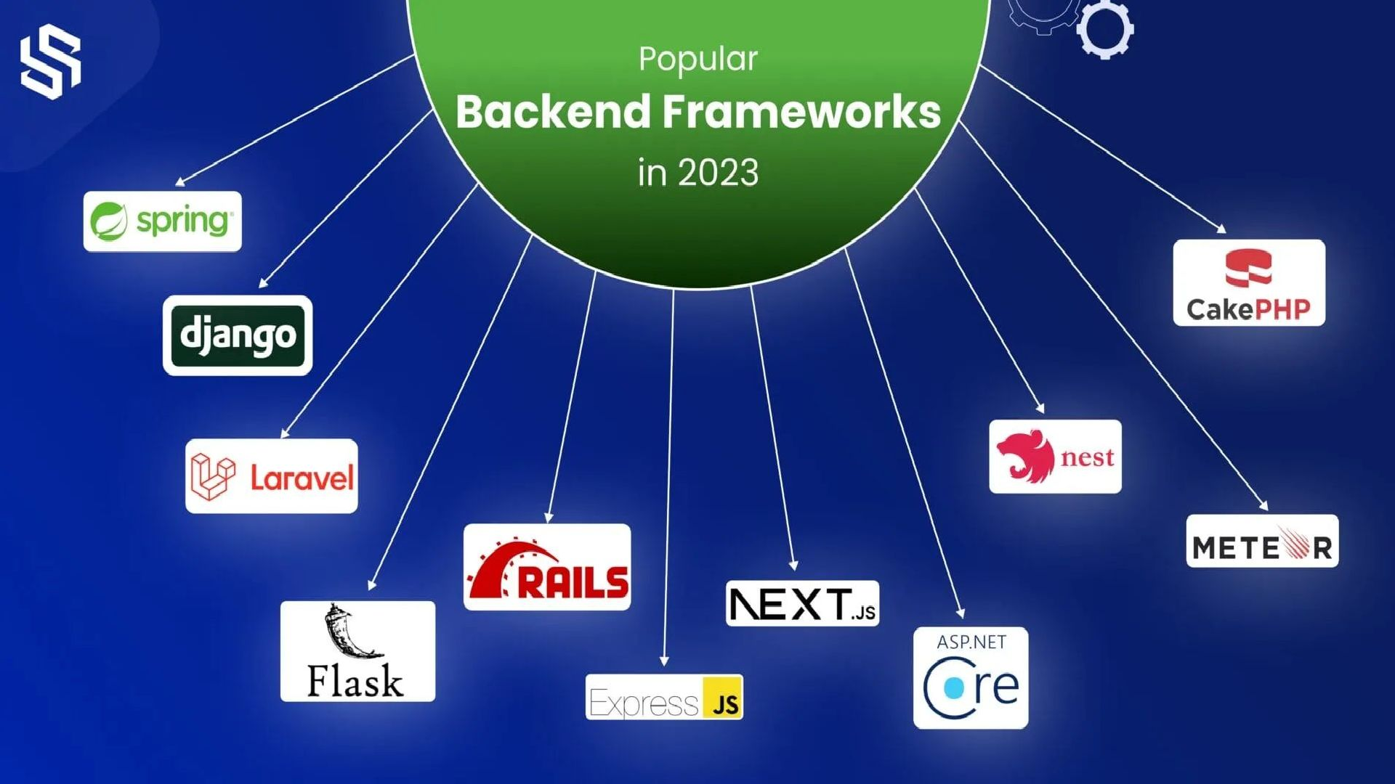

Slide 3



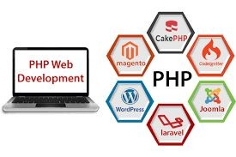


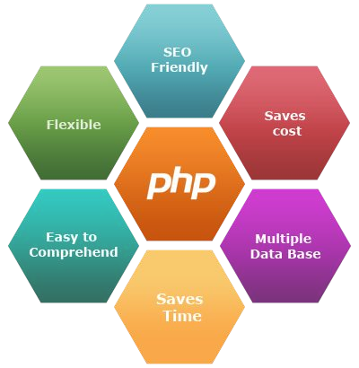

PHP
The term PHP is an acronym for PHP:Hypertext Preprocessor.
PHP is a server-side scripting language(writing the code,implementing on server side), designed specifically for web development.
It is open-source which means it is free to download and use.
It is very simple to learn and use. The files have the extension “.php”.
According to W3 techs, 79.2% web is still powered by PHP.It means PHP is installed on approx 20 million websites and 1 million web servers.

Slide 4
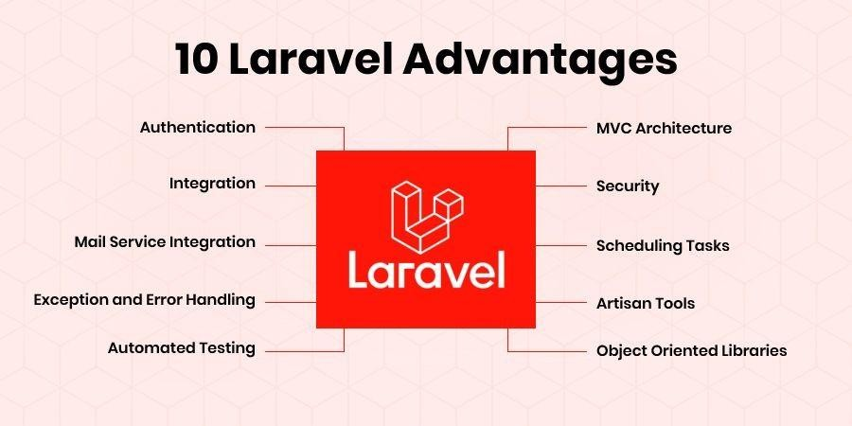
Laravel (PHP FRAMEWORK)
Laravel is a free, open-source PHP
web application framework designed for the development of web applications following the
model-view-controller (MVC) architectural pattern.
Created by Taylor Otwell, Laravel
provides an elegant syntax, a modular packaging system, and various tools to streamline the
development process.

Slide 5
CMS (Content Management System) Platform
WordPress: Known for its user-friendly interface and extensive plugin ecosystem, WordPress powers a significant portion of websites. It's suitable for various purposes, from blogs to e-commerce.It occupy 39% of the market.
Joomla: websites. It provides advanced features and is suitable for community-driven platforms. A versatile CMS offering flexibility and scalability, Joomla is favored for building complex .
Drupal: Geared towards developers and larger enterprises, Drupal excels in handling complex content structures. It offers robust customization options and is suitable for high-traffic websites.
Magento: Specifically designed for e-commerce, Magento is a powerful PHP CMS. It provides advanced e-commerce features, scalability, and is preferred by businesses for online stores.

Slide 6






METEOR:
Meteor.js is an open-source full-stack JavaScript framework for building web, mobile, and desktop applications.
It allows developers to use JavaScript for both client-side and server-side
development.
Features:
Isomorphic Nature: Enables writing code that runs on both the client and
server, enhancing code reusability.
Real-time Data: Built-in support for real-time data synchronization between
clients and servers.
Full-Stack Development: Simplifies the development process by providing a
unified environment for the entire application stack.
Use Cases:
Well-suited for projects requiring rapid development and real-time
capabilities.
Often chosen for applications where a single codebase serves both web and
mobile platforms.

Slide 7
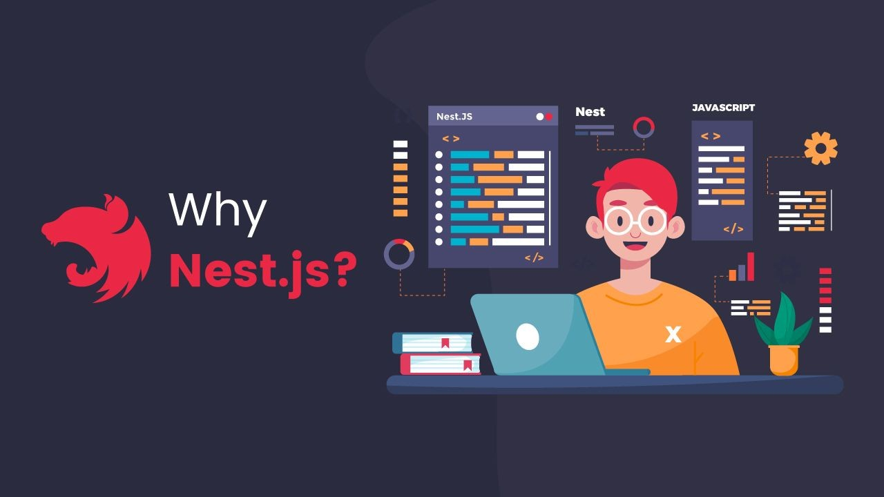
NEST
Nest.js is a progressive Node.js framework for building efficient, scalable web applications, focusing on server-side development.
Utilizes TypeScript for strong typing and modern JavaScript features.
Key Features:
Modularity: Promotes a modular structure, making code organization and maintenance more straightforward.
Decorators: Extensive use of decorators simplifies the creation of controllers, modules, and services.
Dependency Injection: Implements a robust dependency injection system for efficient component management.

Slide 8

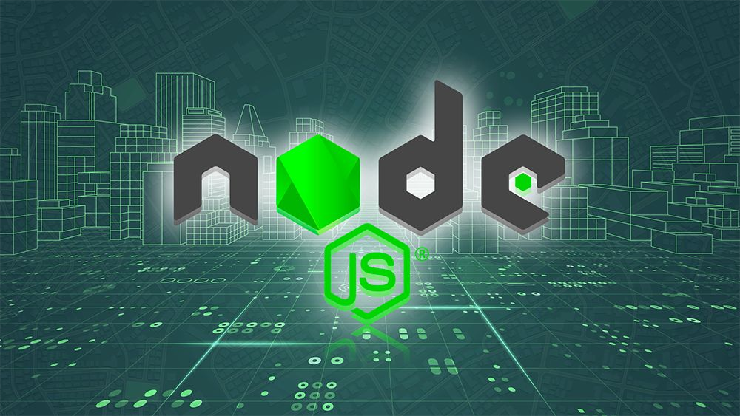
Node.js
NodeJS is an open-source and
cross-platform runtime environment built on Chrome’s V8 JavaScript engine for executing JavaScript code outside of a browser.
It provides an event-driven,
non-blocking (asynchronous) I/O and cross-platform runtime environment for building highly scalable server-side applications using JavaScript.

Slide 9

Express
Express is a Node.js framework designed for building API’s, web applications and cross-platform mobile apps.It gives high performance,fast,not a fixed way to write the code,and lightweight, it is used as a server side scripting language.
Advantages:
Minimal and Lightweight: Provides a basic set of features without
unnecessary complexities
Efficient Development: Simplifies the development process with a set of useful tools and features
Scalability: Scales efficiently, making it suitable for both small projects and large applications
Flexibility: Offers flexibility to customize and use according to project needs
.

Slide 10
PACKAGE MANAGER
NPM (Node Package Manager):
*Original JavaScript package manager.
*Comes bundled with Node.js installation.
*Widely used for managing project dependencies.
*Single registry for packages. npm install
Yarn: *Introduced as an alternative to npm.
*Focuses on speed, reliability, and security.
*Uses a lock file for deterministic dependency resolution.
*Offline mode for faster installations.
*Work in greater than 5 version,take more storage,fast,consistent yarn add

Slide 11


Python Framework
PYTHON FRAMEWORK
Flask:
Micro web framework for Python.
Lightweight and modular.
Provides flexibility with minimal built-in components.
Follows the WSGI standard.
Django:
High-level web framework for Python.
Feature-rich and follows the "batteries-included" philosophy.
Built-in components for ORM, admin panel, and more.
Follows the MVT (Model-View-Template) architectural pattern.

Slide 12


What is Python PIP?
Python PIP is the package manager for Python packages. We can use PIP to install packages that do not come with Python. Pre-installed in above
3.4 version,The basic syntax of PIP commands in the command prompt is: pip-Version or pip-V
Performance Improvement Plan

Slide 13


Ruby
Web Application Framework: RoR is a robust web application framework written in Ruby.
Convention over Configuration (CoC): Emphasizes sensible defaults, reducing the need for configuration. Don't Repeat Yourself (DRY): Encourages code reusability, reducing redundancy.
Advantages of RUBY:
Time Efficiency: Built-in conventions and generators speed up development.
Cost-Effective: Rapid development and a strong community contribute to cost-effectiveness.
Community Support: Active community ensures ongoing support and a wealth of resources.
Model-View-Controller (MVC): Follows a structured architectural pattern for organized development.

Slide 14

Java Backend Development
Java is a well-established and highly favored language for backend development, and for good reason! Here's a breakdown of its strengths and why it might be the perfect fit for your next project:

Slide 15
Some popular Java frameworks for backend development
Spring Framework: The most popular Java framework, highly versatile and modular, offering rich functionality for web development, data access, security, and more. Can be complex for beginners.
Spring Boot: A lightweight Spring framework variant ideal for quick prototyping and microservices development. Easier to learn but less feature-rich than Spring.
Play Framework: A Scala-based framework offering high performance and flexibility for web applications. Steeper learning curve compared to Spring.

Slide 16
Storage
In backend development, "storage" refers to the mechanisms and systems used to persistently store and manage data used by your application. This data can be anything from user accounts and product information to images, videos, and logs.

Slide 17
Here are some popular storage relational databases for backend development:
MySQL: Open-source, widely used, and well-supported, ideal for smaller websites and applications.
MariaDB: Open-source, community-driven fork of MySQL, offering improved performance and scalability.
PostgreSQL: Open-source, ACID-compliant, and feature-rich, suitable for complex applications and large data volumes.

Slide 18
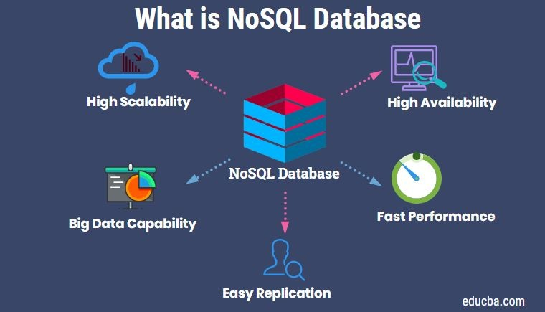
NoSQL database
NoSQL databases offer a different approach to data storage compared to relational databases, making them a good fit for specific backend needs
Here are some popular NoSQL databases for backend development:
MongoDB: A document-oriented database, popular for its flexibility and ease of use.
Cassandra: A columnar database offering high scalability and performance for large datasets.
Firebase: A Google Cloud Platform offering with Realtime Database (document-based) and Cloud Firestore (NoSQL and SQL-inspired).
DynamoDB: A highly scalable and available key-value store from Amazon Web Services.
Redis: An in-memory key-value store ideal for caching and real-time applications.

Slide 19


THANK YOU FOR YOUR ATTENTION

